Slide 1




MIDS Capstone - Spring 2024
Courtney Mazzulla
Julian Rippert
Raymond Tang
Sunny Shin
Karsyn Lee
Leon Gutierrez
Notes:
Courtney

Slide 2






Our Team
Karsyn Lee
Courtney Mazzulla
Sunny Shin
Leon Gutierrez
Raymond Tang
Julian Rippert
Notes:
Courtney - DONT SPEAK

Slide 3
Agenda
1
2
3
Problem Statement
Product Demo
Dataset and EDA
4
5
Technical Approaches
Conclusion
Notes:
Courtney - DONT SPEAK

Slide 4

Notes:
Courtney

Slide 5


PROBLEM STATEMENT
Notes:
Courtney
Image source: https://encrypted-tbn0.gstatic.com/images?q=tbn:ANd9GcQJiHBs2eMAPYnTfDI2WlIU3rojU7NN2hQ7dfg6SuEnXJNZghLSSxd6ys2ndKWwTojY4v4&usqp=CAU

Slide 6
What is Child Grooming?
Grooming or child grooming is the act of deliberately establishing a relationship with a child to prepare them for abuse.
Child grooming and online predatory behavior occur with alarming frequency, leaving a trail of devastating impacts on victims, including profound psychological harm.
Notes:
Courtney - DELETE

Slide 7
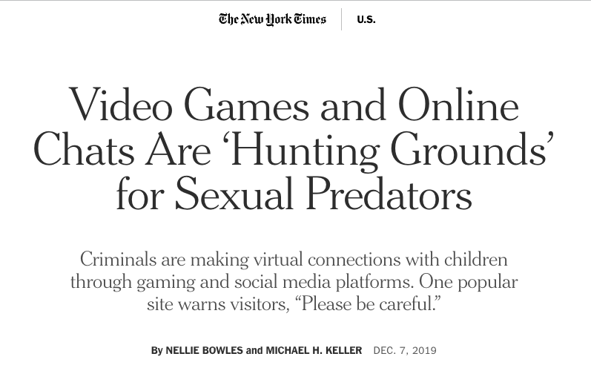
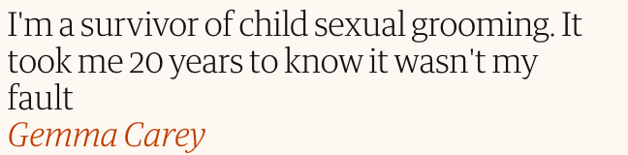
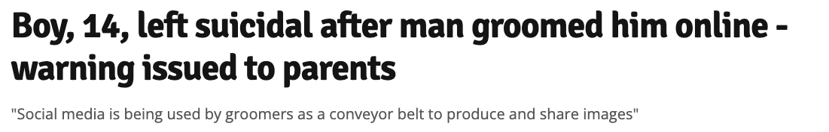
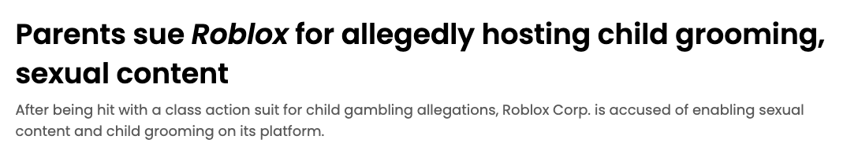
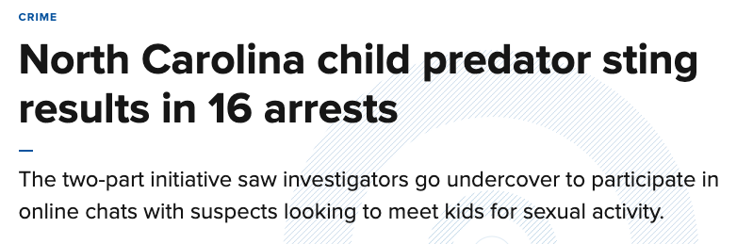
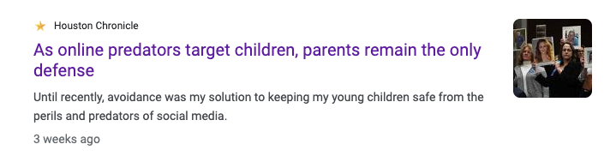
“AN INDUSTRY WITHOUT AN ANSWER”- NYTIMES
Notes:
Courtney
Trigger warning because some of the most important challenges we have to face in society are often times the most uncomfortable. And for our topic, the times said it best… it’s an industry without and answer.
All of these are 2019 and later.
Key themes:
The online world are “hunting grounds”
It’s causing lasting impact on victims, far too many times it ends fatal
It’s happening everywhere and rapidly
Huge companies are getting sued for non-transparency
PARENTS ARE THE ONLY DEFENSE

Slide 8

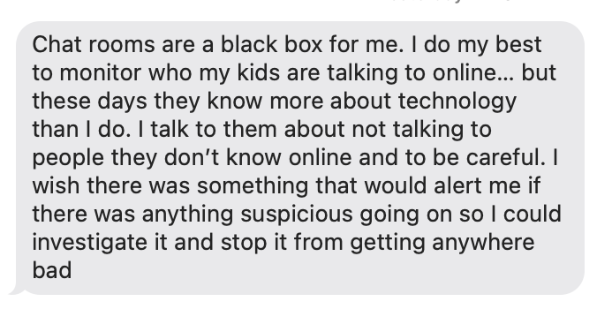
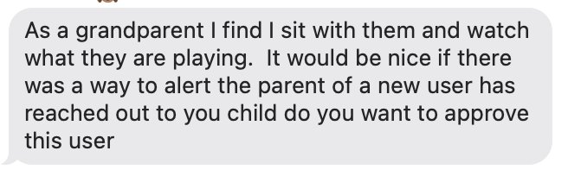
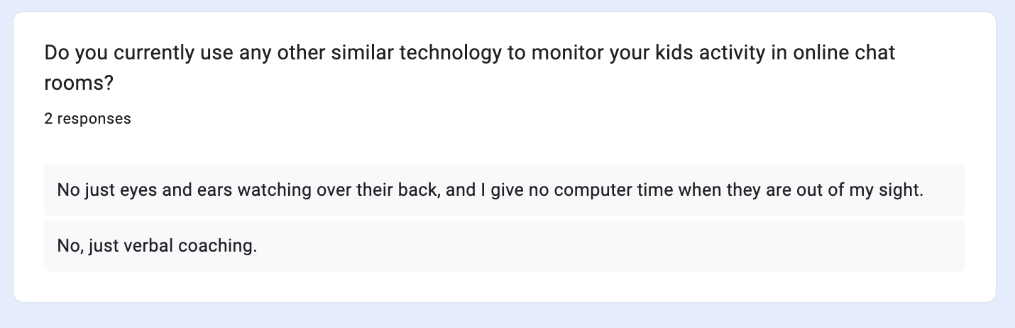
Field Research
Notes:
Courtney

Slide 9
Problem Statement Summary
Who is the Target User?
Parents with children that are minors that are active in online chat rooms.
How We Are Helping?
Increasing parental awareness and involvement to help combat child grooming.
What is the Impact?
In a world where 500,000 online predators are active daily, our impact extends to vulnerable children, offering a safer online experience.
Notes:
Courtney

Slide 10
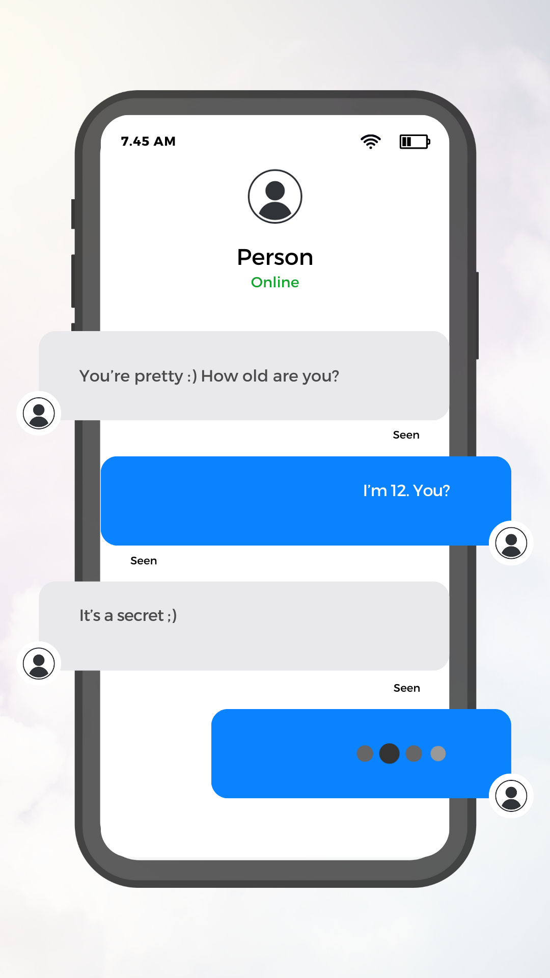
2. PRODUCT DEMO
Notes:
Raymond + Julian
Image reference: Canva

Slide 11

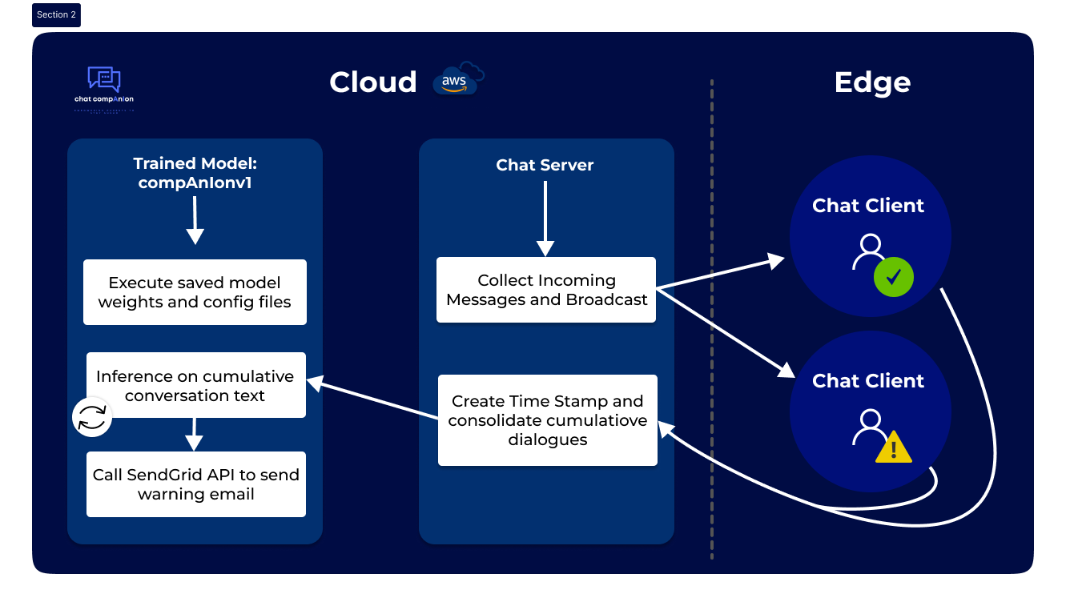
Product Development
Notes:
Raymond

Slide 12


3. DATASETS & EDA
Notes:
Karsyn
Image reference: https://t3.ftcdn.net/jpg/06/74/65/10/360_F_674651033_kzwJq4DyQexuWtffdZAFdBtSyBKjzsEg.jpg

Slide 13

Datasets
PAN12
PJZC
Part of a 2012 competition to analyze sexual predators and identify high risk text
Milon-Flores and Cordeiro put together a new grooming dataset using the same method as PAN12, but with newer data [Source]
True negatives from IRC logs
False positives from Omegle
True positive from Perverted Justice
True negatives from IRC logs (2013-2022)
False positives from chit chats
True positives from PJ (2013-2014)
NOTE: No overlap in data from same sources
Notes:
Karsyn
We use two datasets crucial for analyzing sexual predators and identifying high-risk text: PAN12 from 2012 and the PJZC dataset from 2013 & 2014. Together these provide a comprehensive view of predatory text patterns, encompassing IRC logs, Omegle data, and Perverted Justice records from different time periods.

Slide 14
Conversation Examples
Predator Conversation:
hi Hi Still want to meet on Friday? it's up to you I do What we going to do? want to meet after school tomorrow Can't tomorrow But mom is going to Vegas Friday remember? yes So Friday is good Motel 6 still right? i don't like it there why not?. [....] Yeah wheres it located On the main road how far are you from the casino's Far I'm not allowed to go to the casinos? o ok So you tell me where we meet And can you plz bring that pic?
Non-Predator Conversation:
Why did the chicken cross the road? hiiz Becuz he wanted to be a transexual unicorn nope, to get to your house. :) knock knock! Oh well issn’t that stalkerish of him o.O ...very lol. :) [….] Whats your name if you don’t mind me asking? jacea. like jaysee. spelled funny. u? Kaeleigh :) :p aww. Thats a pretty name! lol Awez :p Thankiez ^_^ my sisters name is keleigh like kelly. so do you have a twitter or tumblr? Neither of those :/ MSN? nope! lol. Facebook? of course! https://www.facebook.com/home.php#!/kaeleighferguson add :) :p ok, i had to log in
Notes:
Karsyn
In our data, we have two different types of conversions flagged. Predator and non-predator. As you can see above, there is some important content highlighted in red in the predator conversation. Those statements are very crucial, as our model detects this language as malicious predator language.
Complex patterns exist in the data, next leon is going to be discussing how we identify them.
Now i’ll be handing it off to leon to talk about technical approaches.

Slide 15


4. TECHNICAL APPROACHES
Notes:
Leon
Image source: https://news.stv.tv/scotland/nspcc-warns-of-more-than-100-monthly-online-sex-crimes-against-children-amid-online-safety-bill-delays

Slide 16
Feature Engineering #1 - Type of Conversation
% Conversations by Type
Large percentages of pair conversations between both classes.
Monologues are considerably more common in the grooming conversations. These might be ineffective attempts by the groomer to contact their victims.
Group conversations rarely occur in both classes, especially in grooming conversations as the groomers prefer to isolate their victims.
Non-grooming
Grooming
65%
61.1%
60%
55%
53.0%
50%
46.9%
45%
40%
35%
23.4%
Percentage of Conversations
30%
25%
20%
15.5%
15%
10%
5%
0%
0.1%
Group
Monologue
Pair
Notes:
Leon

Slide 17


Feature Engineering #2 - Number of Messages Per Conversation
Average Number of Messages per Conversation
100%
Grooming conversations are over 20 messages longer on average than non-grooming conversations.
Grooming conversations tend to be longer because predators need time to slowly create a close bond with the child.
92.8
90%
Non-grooming
80%
Grooming
70%
67.6
60%
Average Number of Messages
50%
40%
30%
20%
10%
0%
Notes:
Leon

Slide 18

Feature Engineering #3 - Start Time of Conversation
Percentage of Conversations by Label and Start Time
Non-grooming
9.0%
Grooming
Peak reached at 21:00
The percentage of grooming conversations peaks between the hours of 6-10 PM
WHY?
Groomers may be more active after working hours
School and work hours see low active user count
8.5%
8.0%
7.5%
7.0%
6.5%
6.0%
5.5%
5.0%
Percentage of conversations
4.5%
4.0%
3.5%
3.0%
2.5%
2.0%
1.5%
1.0%
0.5%
0.0%
00
01
02
03
04
05
06
07
08
09
10
11
12
13
14
15
16
17
18
19
20
21
22
23
Time when a conversation starts
Notes:
Leon

Slide 19
Feature Engineering #4 - Grooming Stages
Research was conducted from various sources, and our team summarized the different key stages of a child grooming conversation:
Trust Words: "trust me", "you can trust", "you can count on me", "I'm here for you", “trust”, “confide”, “you’re safe with me”
1
Personal Info: "what's your", "where do you live", "phone number", "address", “facebook”, “fb”, instagram, “insta”, "give me your", "tell me your", “parent’s home”
Identifying and targeting the victim
2
Gaining trust and access
Sexual Words: “sex”, “f*ck”,” a**hole”, “c*ck’, “b**bs”, “nude”,” h*rrny”, “sexy”, “baby”, “porn”, “d*ck’, “org***”, “naked picture”, “c*m”
3
Playing a role in the child’s life
4
Isolating the child
Pressure Words: "you should", "you have to", "you must", "you need to", "do it now", why haven't you", "when will you", "how come you haven't", "what's taking so long", “don’t tell”
5
Creating secrecy around the relationship
6
Initiating sexual contact
Threatening Words "i'll hurt you", "i'll harm you", "i'll kill you", "hurt", "harm", "kill", "beat", "injure", "damage", "destroy", "punish", "revenge", "pay"
7
Controlling the relationship
Notes:
Sunny
Source: https://safechild.org/understanding-grooming/
Identifying and targeting the victim. Any child or teen may be a potential victim. Some predators may be attracted to children and youth with certain characteristics or may target youth with certain co-existing factors—such as vulnerable parents—to facilitate the crime.
Gaining trust and access. The perpetrator may observe the child and assesses his/her vulnerabilities to learn how best to approach and interact with the child. Perpetrators may offer the victims special attention, understanding and a sympathetic ear, and then engage the child in ways that eventually gain their friendship and trust (they may play games with victims or give them rides, provide them with gifts and/or special treats).
Playing a role in the child’s life. The perpetrator may manipulate the relationship so that it appears he or she is the only one who fully understands the child or meets the child’s needs in a particular way. A perpetrator may also exploit a youth’s empathy and convince the young person that s/he is the only one who understands the perpetrator and reinforce that the perpetrator “needs” the child or youth.
Isolating the child. Offering the child rides and/or taking the child out of his or her surroundings is one way that the perpetrator may separate the child from others and gain access to the child alone, so that others cannot witness the abuse. (Note that in other instances, perpetrators have been successful in molesting victims without detection while other adults were in the room.)
Creating secrecy around the relationship. The perpetrator may reinforce the special connection with the victim when they are alone or through private communication with the victim (such as letters emails, or text messages), and strengthen it with admonitions against telling anyone, lest others be unhappy about it. The perpetrator may threaten the victim with disclosure, suicide, physical harm to the child or loved ones, or other traumas if he or she tells.
Initiating sexual contact. With the power over the child victim established through emotional connection coercion or one of the other tactics, the perpetrator may eventually initiate physical contact with the victim. It may begin with touching that is not overtly sexual (though a predator may find it sexually gratifying) and that may appear to be casual (arm around the shoulder, pat on the knee, etc.). Gradually, the perpetrator may introduce more sexualized touching. By breaking down inhibitions and desensitizing the child, the perpetrator can begin overtly touching the child.
Controlling the relationship. Perpetrators rely on the secrecy of the relationship to keep it going, and to ensure that the child will not reveal the abuse. Children are often afraid of disclosing the abuse. They may have been told that they will not be believed, or that something about the child “makes” the abuser do this to them. The child may also feel shame, or fear that they will be blamed. Often, the perpetrator threatens the child to ensure that s/he won’t disclose the abuse.

Slide 20


Methods to Deal with Imbalanced Dataset
Before up/down sampling
Non-grooming
2. Filter out non-grooming conversations from PJZC
95.5%
4.5%
1. Up/down sampling
Grooming
4. Test different probabilistic losses
After up/down sampling
Non-grooming
3. Create synthetic data
75.1%
24.9%
Grooming
Notes:
Sunny

Slide 21
Model Development Journey
F3 Scores*
XGBoost
Test: 0.499
Logistic Regression
Test: 0.499
Decision Tree
Test: 0.368
ML Lib
Baseline
Random Forest
Test: 0.492
Gradient-Boosted Tree
Test: 0.412
Processed data
GPT2
Test: 0.301
Logistic Regression
Test: 0.339
Neural Network
Test: 0.580
Spark NLP BERT
Test: 0.665
BERT
BERT-NN
Test: 0.580
BERT Pooler
Test: 0.606
Best
model
TensorFlow BERT
BERT Averaging
Test: 0.727
BERT-CNN-NN
Test: 0.828
BERT CLS
Test: 0.724
*F3 Scores puts more weight on recall
Notes:
Sunny

Slide 22

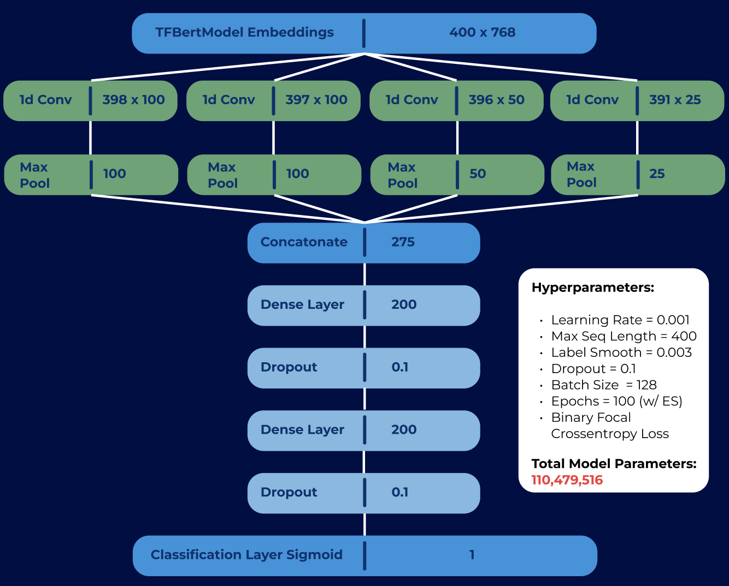

Final Model Overview
Notes:
Sunny

Slide 23


5. CONCLUSION AND NEXT STEPS
Notes:
Julian

Slide 24
Mission Statement
“At Chat CompAnIon, we are dedicated to revolutionizing online safety by empowering parents with a vigilant ally in safeguarding their children, fostering secure gaming chat environments through cutting-edge AI technology.”
Notes:
Julian
Wrapping up with our mission we really want to stress that we are dedicated to revolutionizing online safety by empowering parents to creat sure gaming chat environments
Say we are here to help the child grooming problem

Slide 25

Next Steps
NEW PRODUCT FEATURES
ADDITIONAL USER TESTING
With data privacy in mind, pull in user’s data in the notification email for additional context to parents and chat room moderators
Continue user testing to help identify model weaknesses and new value-add opportunities
PARTNERSHIP
NEW PRODUCT USE-CASES
Partner with home security and cyber companies for additional applicability
Explore new use-cases such as elderly scam prevention and cyber bullying
Notes:
Julian

Slide 26





Thanks For Watching
Connect with us.
Email
Website
GitHub
YouTube
Hugging Face
Notes:
Julian

Slide 27
Acknowledgements
Joyce Shen and Korin Reid
Capstone Advisors
Mark Butler
Practical Applications of Natural Language Processing Professor at University of California, Berkeley
Robert Wang
Cloud Solutions Architect at AWS
Thanks to our Capstone advisors and everyone else who helped us along the way for their exhaustive guidance and continued support

Slide 28
References
F.Milon-Flores, Daniela, L.F. Cordeiro, Robson. 2022. How to take advantage of behavioral features for the early detection of grooming in online conversations. [online] ScienceDirect. Available at: https://www.sciencedirect.com/science/article/pii/S0950705121011187
Matthias Vogt, Ulf Leser, and Alan Akbik. 2021. Early Detection of Sexual Predators in Chats. In Proceedings of the 59th Annual Meeting of the Association for Computational Linguistics and the 11th International Joint Conference on Natural Language Processing (Volume 1: Long Papers), pages 4985–4999, Online. Association for Computational Linguistics.
Rezaee Borj, Parisa, Raja, Kiran, Hours, Patrick. 2023. Online grooming detection: A comprehensive survey of child exploitation in chat logs. [online] ScienceDirect. Available at: https://www.sciencedirect.com/science/article/pii/S0950705122011327#b74
Sinnamon, Grant. 2017. The Psychology of Adult Sexual Grooming: Sinnamon’s Seven-Stage Model of Adult Sexual Grooming. [online] ScienceDirect. Available at: https://www.sciencedirect.com/science/article/abs/pii/B978012809287300016X
Y. -G. Cheong, A. K. Jensen, E. R. Guðnadóttir, B. -C. Bae and J. Togelius, "Detecting Predatory Behavior in Game Chats," in IEEE Transactions on Computational Intelligence and AI in Games, vol. 7, no. 3, pp. 220-232, Sept. 2015, doi: 10.1109/TCIAIG.2015.2424932. keywords: {Games;Context;Machine learning algorithms;Feature extraction;Media;Social network services;Labeling;Chat;data mining;game data;natural language processing (NLP);preprocessing;sexual predator;text classification},
Logo and video banner were made using Canva
Followed this Youtube tutorial to create chat room: https://www.youtube.com/watch?v=mkXdvs8H7TA

Slide 29
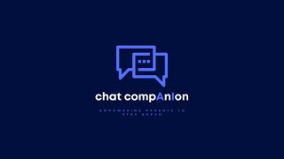
Notes:
Raymond + Courtney
Saying here is X, we are here to show X, and here is what we are mimicking in the real world

